Slide 1
Reddit Comments Classification Project
By Moises Salazar

Slide 2
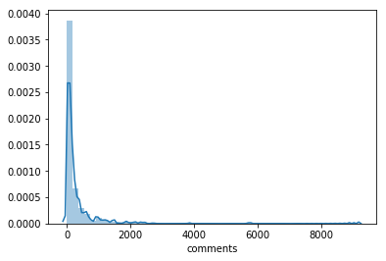
Comments Distribution
Heavily skew to the left size
The effect of extreme values is clear

Slide 3
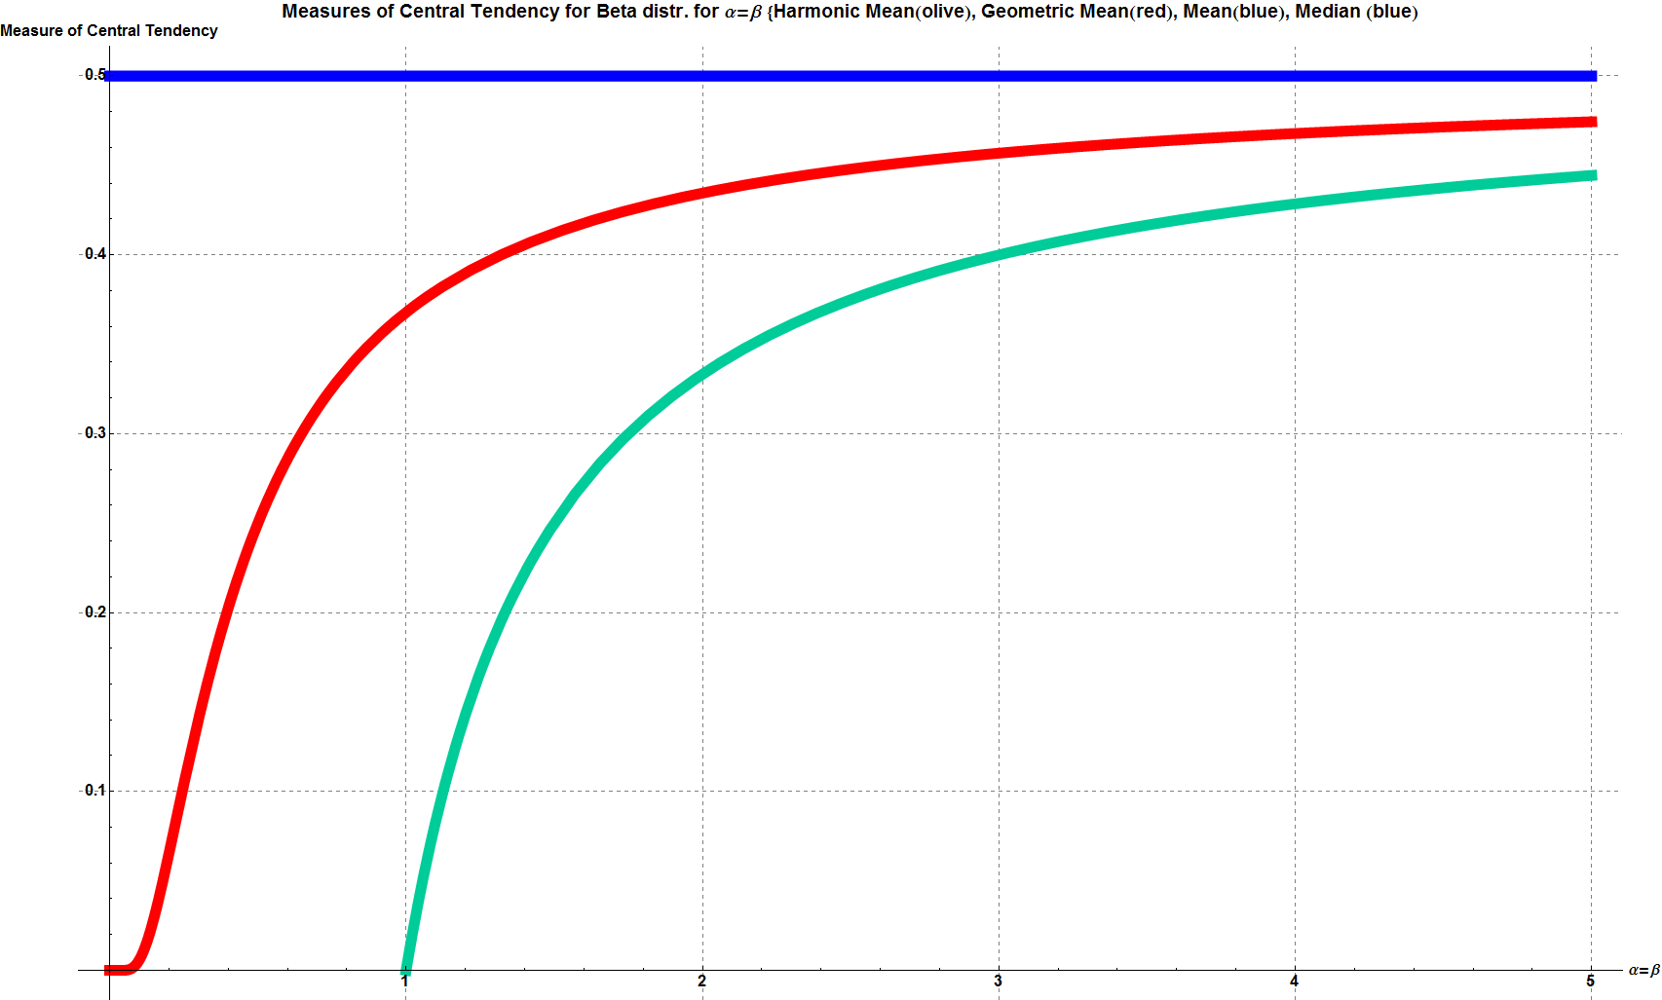
On Average, You’re Using the Wrong Average: Geometric & Harmonic Means in Data Analysis
Properties of the Gmean:
-Do not seem affected by the sample sizes in this application
-It a measure of compounding factors
-Describe growth very well
https://towardsdatascience.com/on-average-youre-using-the-wrong-average-geometric-harmonic-means-in-data-analysis-2a703e21ea0

Slide 4
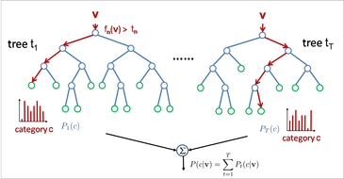
Tool employed :
There is not need for “Einstein models”
It is an ensemble method
They use Conditional Probability “under the hood”
-
-

Slide 5
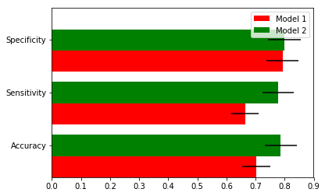
Results From RF Model using NLP:
Most of the text features where low in importance
Some text feature obtained through NLP show some potential
Best performing features weren’t obtained through NLP

Slide 6
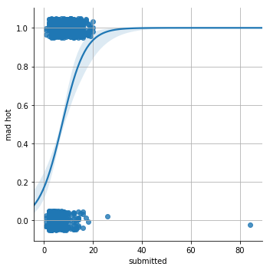
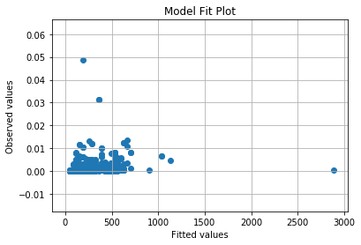
Potential classifiers
Logistic Regression
GLM Gamma

